Slide 1

Organizational Behavior
(MGT-502)
Lecture-28

Slide 2
Summary of
Lecture-27

Slide 3
Today’s Topics

Slide 4
Review Part-II

Slide 5
Basic OB Model
Organization
systems level
Group
level
Individual
level

Slide 6
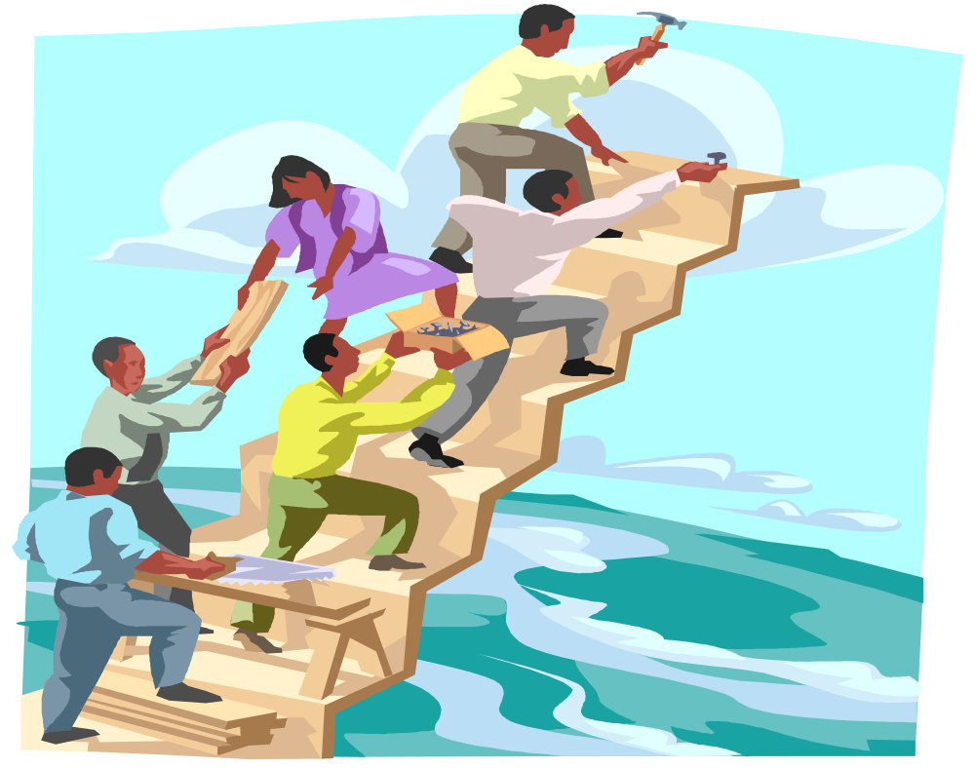
Groups Dynamics

Slide 7
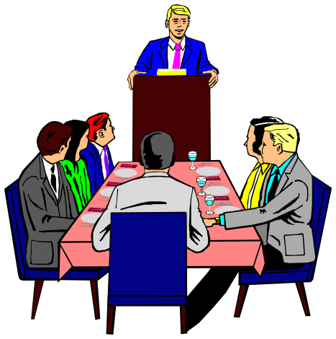
Groups Defined
Two or more individuals interacting with each other in order to accomplish a common goal.

Slide 8
Groups & Teams
Group - two or more people with common interests or objectives
Team - a small number of people with complementary skills who are committed to a common mission, performance goals, and approach for which they hold themselves mutually accountable

Slide 9
Why Do People Join Groups?
Security
Status
Social needs
Power
Goal Achievement
Notes:
11/1/01
3

Slide 10
Performing
Norming
Adjourning
Storming
Forming
Return to
Independence
Dependence/
interdependence
Independence

Slide 11
Effects of Group Processes
Potential group
effectiveness
+
Synergy
-
Process
losses
=
Actual group
effectiveness
Notes:
11/1/01
9

Slide 12
Group Roles
Task-Oriented
Roles:
Initiators
Information Seekers
Opinion Givers
Energizers
Relations-
Oriented Roles:
Harmonizers
Compromisers
Encouragers
Expediters
+
Task
Performance
+
-
Self-Oriented
Roles:
Blockers
Recognition Seekers
Dominators
Avoiders

Slide 13


Teams

Slide 14
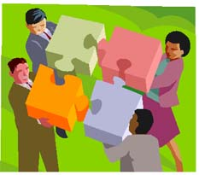
Teams
Teams are groups with greater interdependence--shared purpose and destiny. Can be higher performing than groups, but may not be...

Slide 15





Problem-
Solving
Self-
Managed
Types of
Teams
Virtual
Cross-
Functional

Slide 16
Turning Individuals
Into Team Players
Selection
Training
Rewards

Slide 17
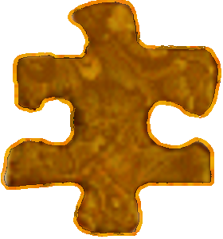

T
E
A
M
ogether
veryone
chieves
ore

Slide 18
Is it true that
everyone’s
responsibility is, in
reality, nobody’s
responsibility?
-- Anonymous

Slide 19

Group Problem Solving Techniques
Consensus presenting opinions and gaining agreement to support a decision
Brainstorming process to generate a quantity of ideas
Nominal Group Technique process to generate ideas and evaluate solutions
Delphi Technique process to generate ideas from physically dispersed experts
Computer-Aided Decision Making

Slide 20
Group Phenomenon
Groupthink - a deterioration of mental efficiency, reality testing, and moral judgment resulting from in-group pressures
Group Polarization - the tendency for group discussion to produce shifts toward more extreme attitudes among members

Slide 21
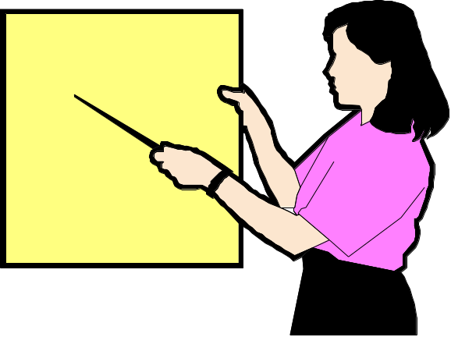
Communication Defined
The transmission of information and understanding through the use of common symbols.

Slide 22
The Communication Process
Encoding
Channel
Decoding
Message
Message
Source
Receiver
Feedback

Slide 23
Department
Manager
Supervisor
Supervisor

Slide 24
Directions of Communications

Slide 25

Functions of Communication
Control
Motivation
Information
Emotional
Expression

Slide 26
What Will Your Audience Remember?
More
How Much is
Remembered
As time passes, your audience remembers less.
Less
How Much Time Passes
More

Slide 27
Technology and Communication
Electronic Mail
The Internet
Notes:
14

Slide 28

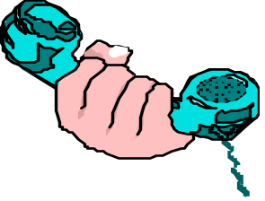
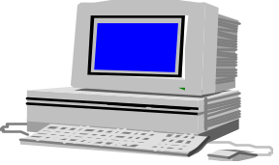

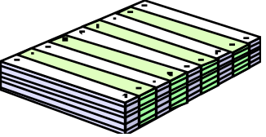
Hierarchy of Channel Richness
Channel
richness
Type of
message
Information
medium
Richest
Nonroutine,
ambiguous
Face to face
talk
Telephone
Computer
Memos,
letters
Flyers, bulletins
general reports
Leanest
Routine,
clear
Notes:
10/28/01
5

Slide 29
Improving Communication in Organizations

Slide 30
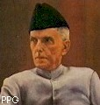

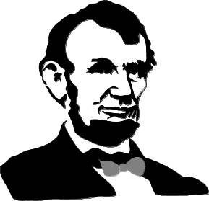
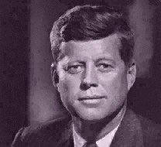
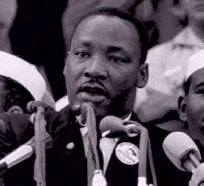
Leadership

Slide 31
Leadership Is a Process, Not a Position
Leader
Followers
Leadership
Situation

Slide 32
Leaders & Managers

Slide 33
Distinctions Between Managers and Leaders
Leaders
  Innovate
  Develop
  Inspire
  Take the long-term view
  Ask what and why
  Originate
  Challenge the status quo.
Managers
  Administer
  Maintain
  Control
  Have a short-term view
  Ask how and when
  Accept the status quo

Slide 34
Specific Team Leadership Roles
Coach
Liaison with
external
constituencies
Team
Leadership
Roles
Conflict
manager
Troubleshooter

Slide 35
Trust and Leadership
Leadership
TRUST
and
INTEGRITY

Slide 36
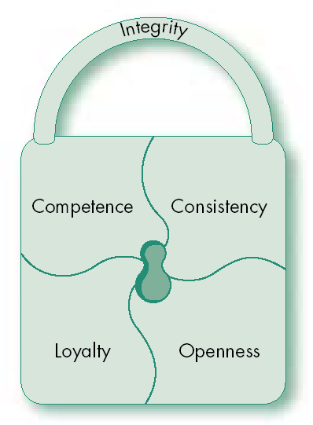
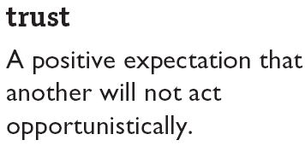
Trust: The Foundation of Leadership

Slide 37
Power
What is it?
Do you have any?
Do you want some?
How can you get some?

Slide 38
Concept of Power
Power - the ability to influence another person
Influence - the process of affecting the thoughts, behavior, & feelings of another person
Authority - the right to influence another person
Notes:
2

Slide 39

Sources of Organizational Power: Interpersonal
Reward Power - agent’s ability to control the rewards that the target wants
Coercive Power - agent’s ability to cause an unpleasant experience for a target
Legitimate Power - agent and target agree that agent has influential rights, based on position and mutual agreement
Referent Power-based on interpersonal attraction
Expert Power - agent has knowledge target needs
Notes:
4

Slide 40
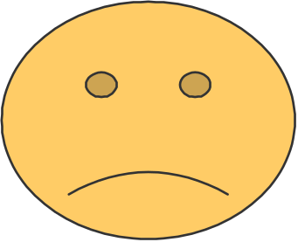

Two Faces of Power
Personal Power
  used for personal gain
Social Power
  used to create motivation
  used to accomplish group goals
Notes:
7

Slide 41
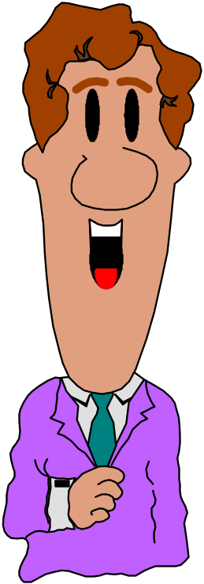
ORGANIZATIONAL POLITICS
I’ll support your bill if you support mine
The use of power in non-prescribed ways (means) and/or for non-prescribed purposes (ends)

Slide 42
Types of Organizational Politics
Managing
impressions
Attacking and
blaming
Types of
Organizational
Politics
Creating
obligations
Controlling
information
Cultivating
networks
Forming
coalitions

Slide 43
Conditions for Organizational Politics
Personal
Characteristics
Scarce
Resources
Conditions
Supporting
Organizational
Politics
Tolerance of
Politics
Complex and
Ambiguous
Decisions

Slide 44
Dependency: The Key To Power

Slide 45
Managing Organizational Politics
Reduce System Uncertainty
Reduce Competition
Break Existing Political Fiefdoms

Slide 46
Controlling Political Behavior
Provide
Sufficient
Resources
Remove
Political Norms
Introduce
Clear Rules
Hire
Low-Politics
Employees
Free Flowing
Information
Increase
Opportunities
for Dialogue
Manage Change
Effectively
Peer Pressure
Against Politics

Slide 47
Definition of Conflict
Perceived by the parties
Parties are in opposition to one another
At least one party is blocking the goal attainment of the other party
Goals can be tangible or psychological
  Money
  Task Achievement
  Happiness

Slide 48
Transitions in Conflict Thought
Traditional
View
Human
Relations
View
Interactionist
View

Slide 49
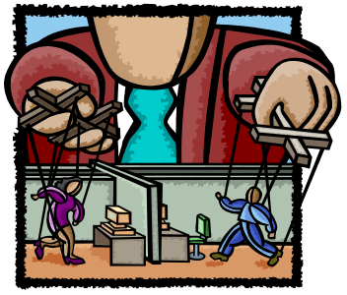
Sources of conflict
Organizational hierarchy
Competition for scarce resources
Self-image & stereotypical views of others
Differing goals & objectives
Failures & resultant blame fixing
Poor coordination of activities

Slide 50
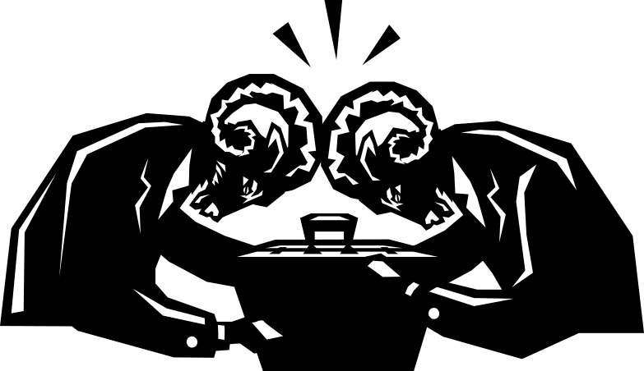
Conflict Management
Conflict at Work

Slide 51
Five Conflict Management Styles
Competing
Collaborating
Assertive
Compromising
Assertiveness
Unassertive
Avoiding
Accommodating
Uncooperative
Cooperative
Cooperativeness

Slide 52
Negotiation
Negotiation - a joint process of finding a mutually acceptable solution to a complex conflict
Useful under these conditions
  Two or more parties
  Conflict of interest between the parties
  Parties are willing to negotiate
  Parties prefer to work together rather than to fight openly, give in, break off contact, or take the dispute to a higher authority
Notes:
23

Slide 53
Steps in a Negotiation
Identify the problem
Define the goal
Record the facts
Anticipate outcomes
Notes:
5

Slide 54
Bargaining Zone Model
Your Positions
Initial
Target
Resistance
Area of
Potential
Agreement
Resistance
Target
Initial
Opponent’s Positions

Slide 55
Determine the Negotiation Outcome
Win/lose
Lose/lose
Win/win
Notes:
11

Slide 56

Third-Party Negotiations

Slide 57
Third-Party Objectives
Procedural
Fairness
Efficiency
Third-Party
Conflict Resolution
Objectives
Outcome
Fairness
Effectiveness

Slide 58
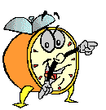
Let’s stop it here

Slide 59
Summary

Slide 60
“Madness is the exception in individuals but the rule in groups”
F. Nietzche

Slide 61
Next….

Slide 62
Basic OB Model
Organization
systems level
Group
level
Individual
level

Slide 63
Organizational Behavior
(MGT-502)
Lecture-28

